Slide 1
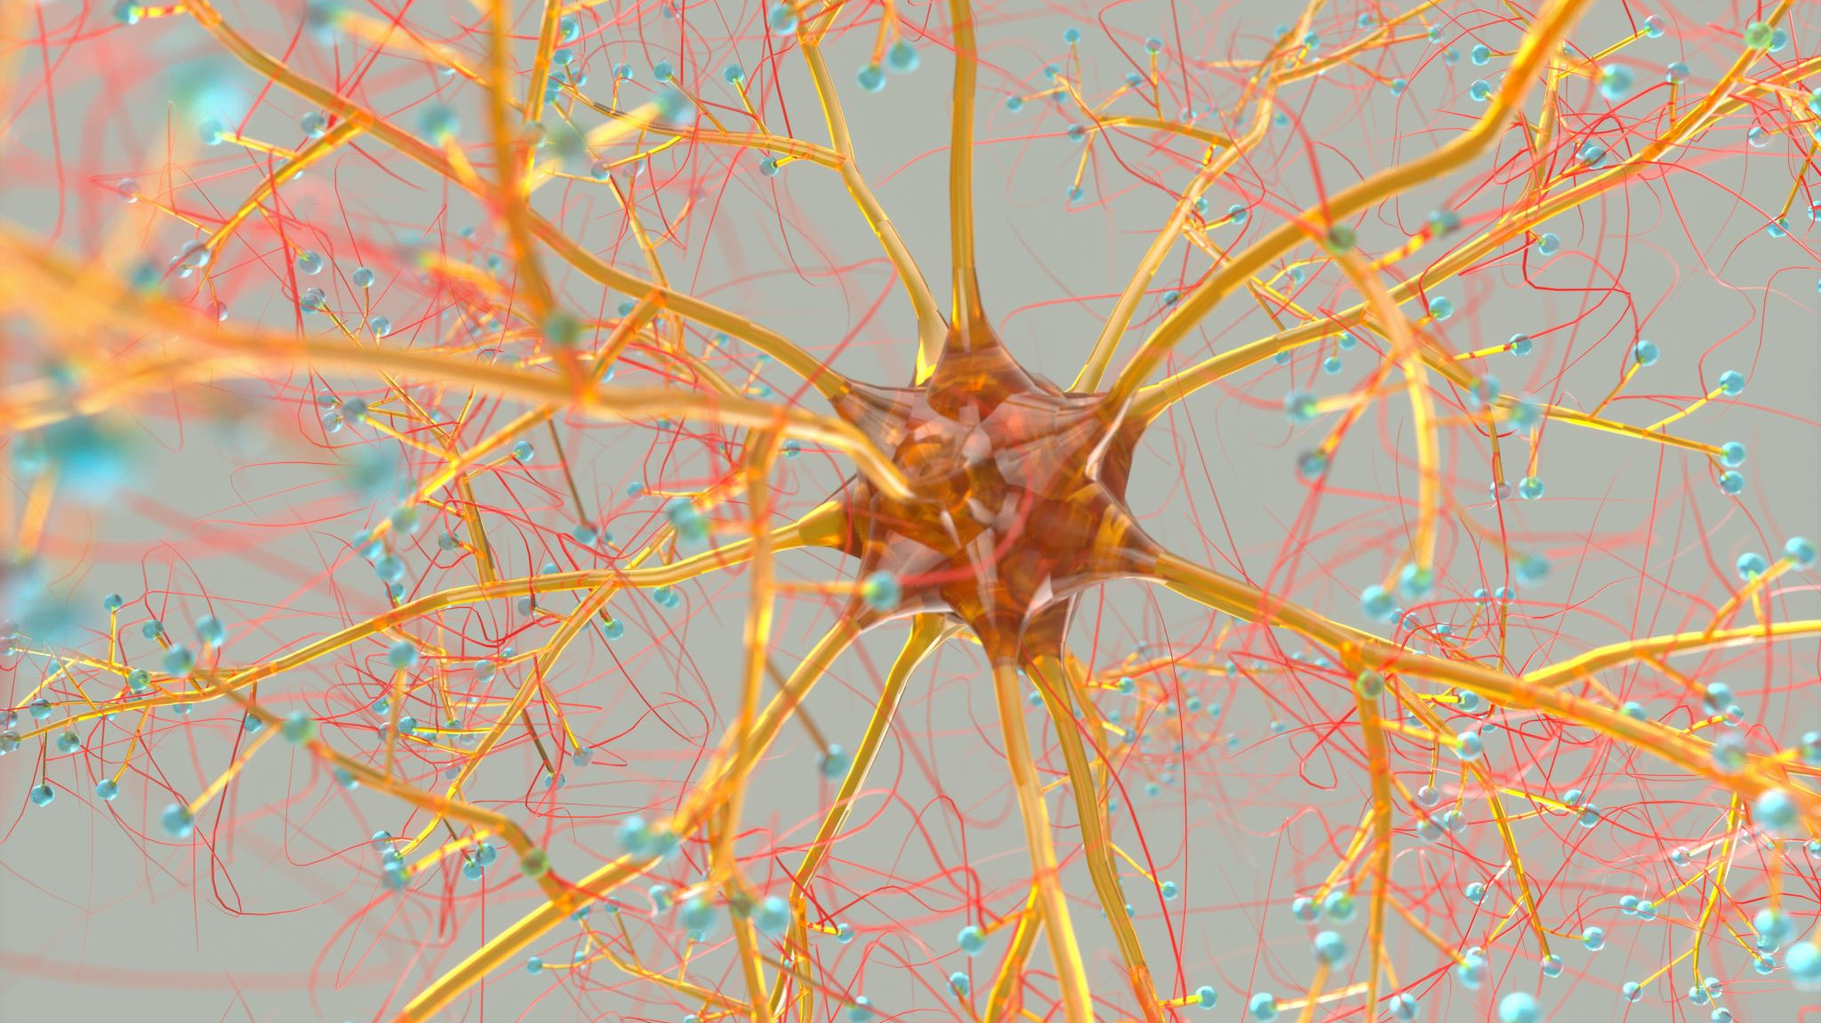
Nervous system neoplasm
A presentation by Michelle Gull and Lena Schneider

Slide 2
Introduction
Many different tumour types can affect the nervous system
Develop in the brain and spinal cord
Symptoms vary depending on location and size
Can be benign / malignant
A CNS tumor is especially problematic because a person’s thought processes and movements may be affected
CNVs are often age and region specific

Slide 3
WHO Classification of Tumors of the Nervous System
Tumors of Neuroepithelial Tissue
Astrocytic Tumors
Diffuse astrocytoma; Anaplastic astrocytoma; Glioblastoma; Pilocytic astrocytoma; Pleomorphix xanthoastrocytoma; Subependymal giant cell astrocytoma
Oligodendroglial Tumors
Oligodendroglioma; Anaplastic oligodendroglioma
Mixed gliomas
Oligoastrocytoma; Anaplastic oligodendrogliomas
Ependymal tumors
Ependymoma; Anaplastic ependymoma; Myxopapillary ependymoma; Subependymoma
Choroid plexus tumors
Choroid plexus papilloma; Choroid plexus carcinoma
Glial tumors of uncertain origin
Astroblastoma; Gliomatosis cerebri; Chordoid glioma of the 3rd ventricle
Neuronal and mixed neuronal-glial tumors
Gangliocytoma; Dysplastic gangliocytoma of cerebellum; Desmoplastic infantile astrocytoma/ganglioglioma; Dysembryoplastic neuroepithelial tumor; Ganglioglioma; Anaplastic ganglioglioma; Central neurocytoma; Cerebellar liponeurocytoma; Paraganglioma of the filum terminale
Neuroblastic tumors
Olfactory neuroblastoma; Olfactory neruoepithelioma; Neuroblastomas of the adrenal gland and sympathetic nervous system
Pineal parenchymal tumors
Pineocytoma; Pineoblastoma; Pineal parenchymal tumor of intermediate. differentiation
Embryonal tumors
Medulloepithelioma; Ependymoblastoma; Medulloblastoma; Supratentorial primitive neuroectodermal tumor (PNET); Atypical Teratoid/Rhabdoid Tumors

Slide 4
WHO Classification of Tumors of the Nervous System
Tumors of Peripheral Nerves
Schwannoma
Neurilemmoma, Neurinoma
Neurofibroma
Perineurioma
Intraneural Perineurioma; Soft Tissue Perineurioma
Malignant peripheral nerve sheath tumor (MPNST)
Tumors of the Meninges
Tumors of meningothelial cells
Meningiomas
Mesenchymal, non-meningothelial tumors
Lipoma; Angiolipoma; Hibernoma; Liposarcoma (intracranial); Solitary fibrous tumor; Fibrosarcoma; Malignant fibrous histiocytoma; Leiomyoma; Leiomyosarcoma; Rhabdomyoma; Rhabdomyosarcoma; Chondroma; Chondrosarcoma; Osteoma; Osteosarcoma; Osteochondroma; Hemangioma; Epithelioid hemangioendothelioma; Hemangiopericytoma; Angiosarcoma; Kaposi sarcoma
Primary melanocytic lesions
Diffuse melanocytosis; Melanocytoma; Malignant melanoma; Meningeal melanomatosis
Tumors of uncertain histogenesis
Hemangioblastoma

Slide 5
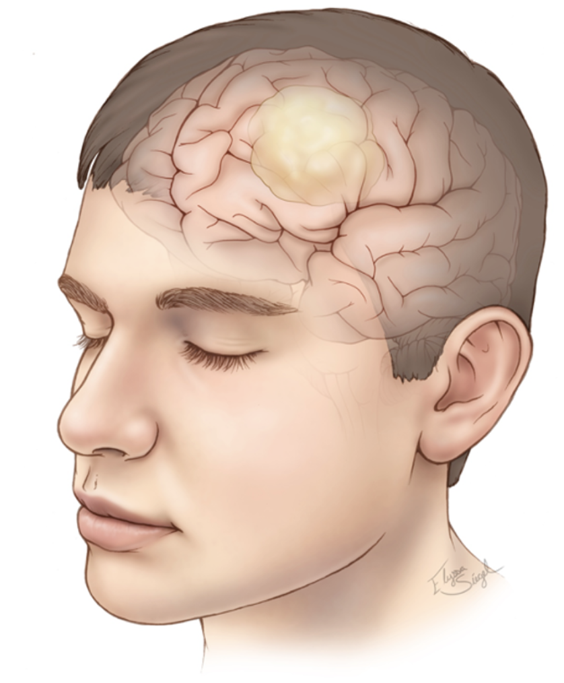
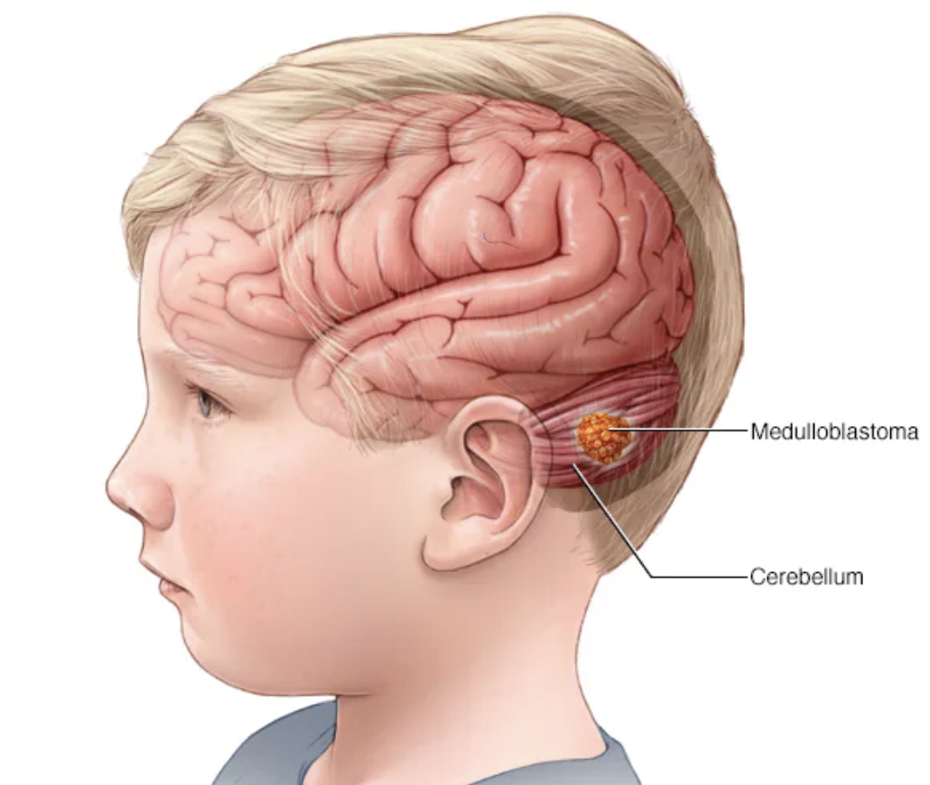
Common brain tumors
Glioblastoma
- most malignant and invasive type of astrocytoma
- cure is often not possible
- most common form of primary brain tumor among adults
- symptoms include headaches, nausea and seizures
Medulloblastoma
- starts in the cerebellum
- can occur at any age, but mostly in young children
- most common cancerous brain tumor in children
- symptoms include headaches, nausea and poor coordination
Notes:
(grade IV astrocytoma) and unfortunately the most common form of primary brain tumor among adults; glioblastoma is also called glioblastoma multiforme and is brain cancer.

Slide 6
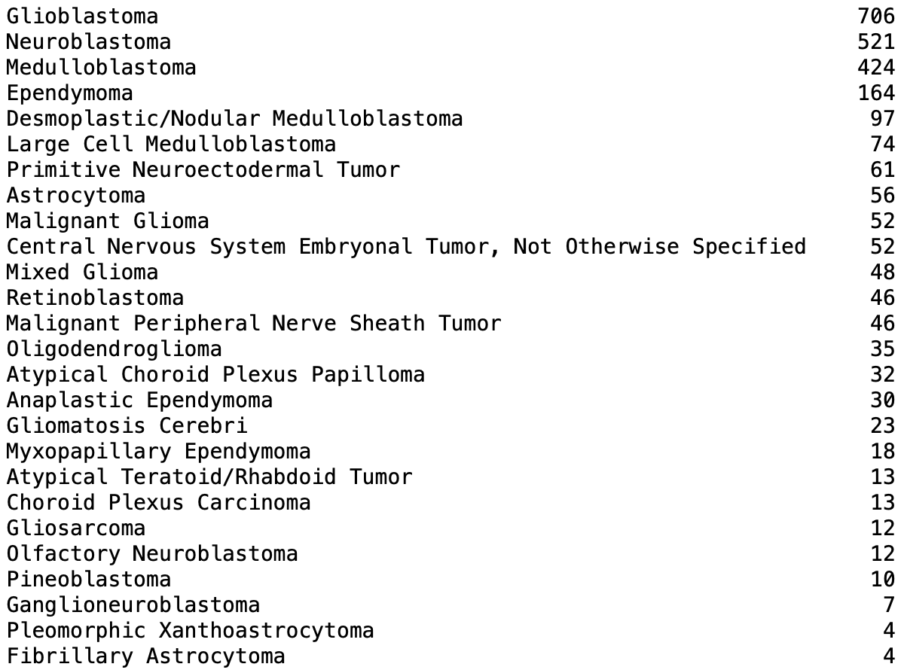
Our data
2560 samples
1379 samples with CNVs in 4 genes
26 tumor types
From all age groups

Slide 7
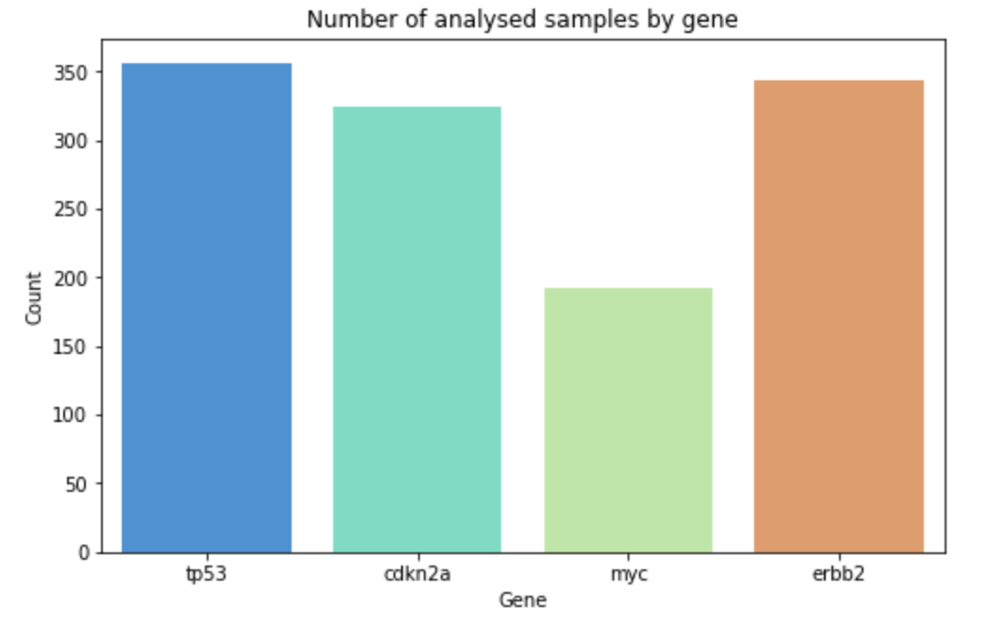
Analysed Genes

Slide 8
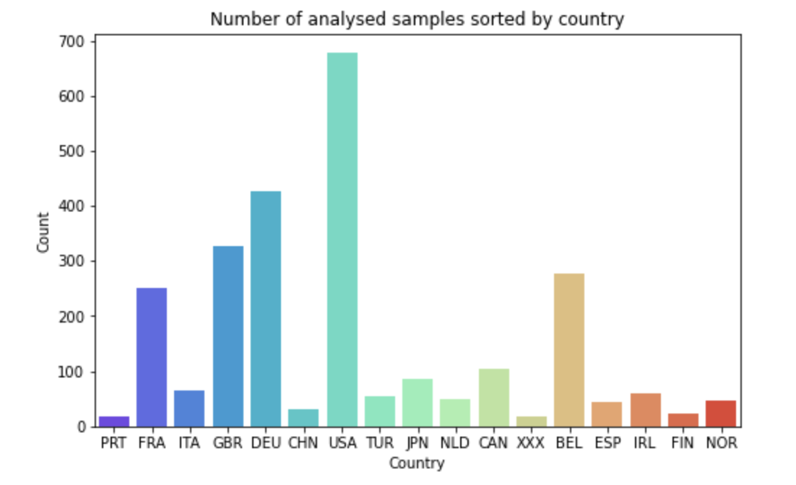
Locations of our samples

Slide 9
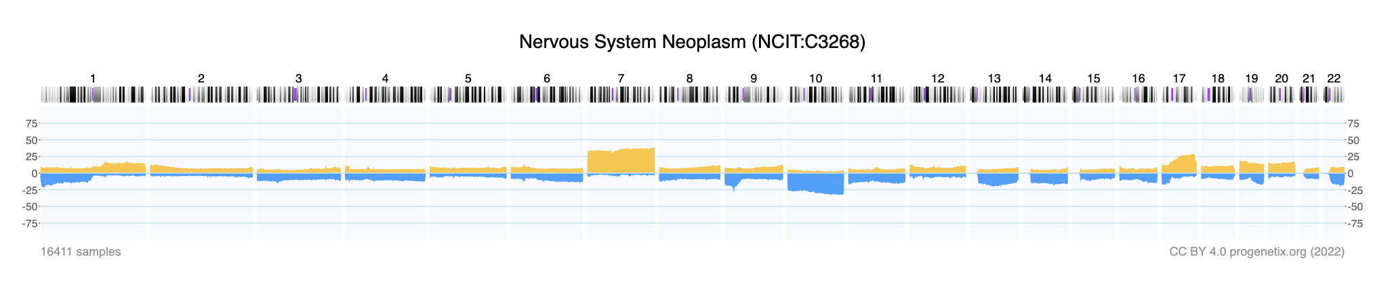
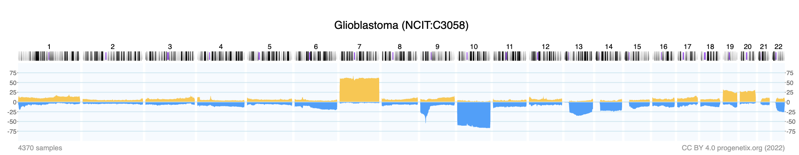
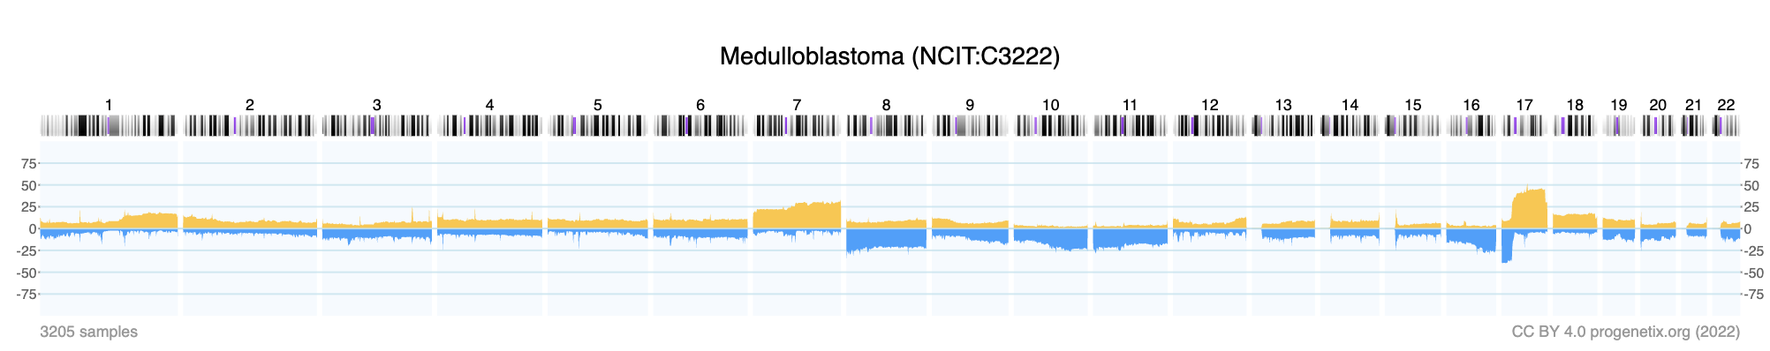
Progenetix Search Samples of Nervous System Neoplasm
Gene Locations
ERBB2(+) : 17q12
TP53(-) : 17p13.1
MYC(+) : 8q24.21
CDKN2A(-) : 9p21.3
Notes:
Recurrent cytogenetic aberrations in medulloblastoma specimens essentially resulting in the net loss of one copy of the chromosome 17 p-arm and a net gain of one copy of the q-arm, is a signature event in medulloblastoma, found in up to 50 % of patient samples.
Interestingly, 8q gain is one of the most frequent cytogenetic abnormalities of diffuse astrocytoma.

Slide 10
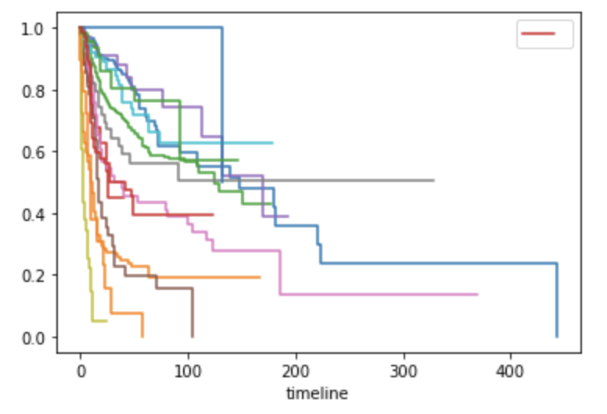
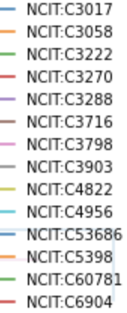
Kaplan Meier: Survival based on Tumor Type
Survival function
Ependymoma
Glioblastoma
Medulloblastoma
Neuroblastoma
Oligodendroglioma
Primitive Neroectodermal Tumor
Malignant Peripheral Nerve Sheath Tumor
Mixed Glioma
Malignant Glioma
Desmoplastic/Nodular Medulloblastoma
Atypical Chorid Plexus Papilloma
CNS Ebryonal Tumor
Astrocytoma
Large Cell Medulloblastoma
Survival fraction

Slide 11
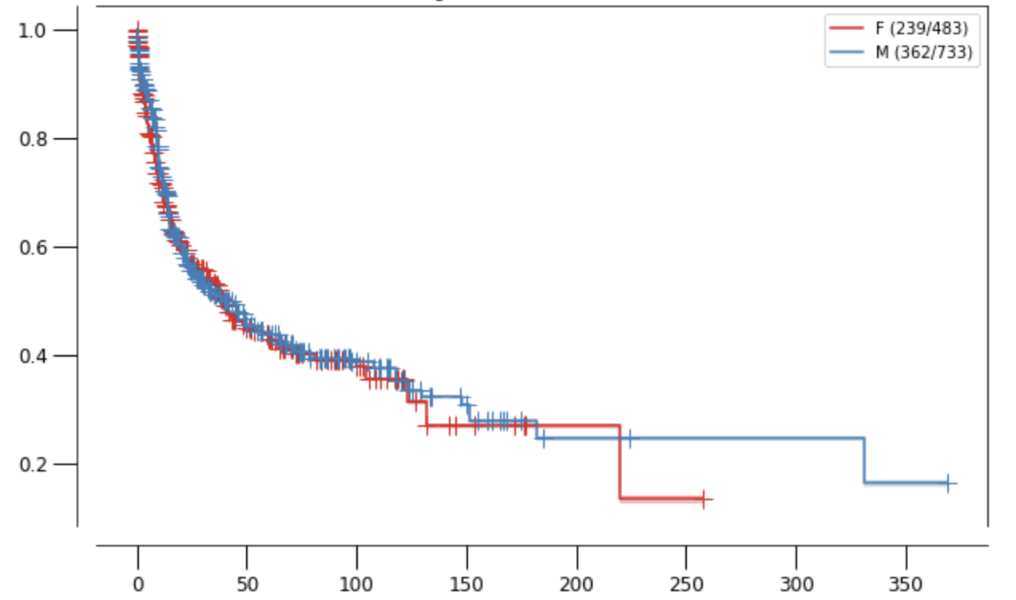
Kaplan Meier Plot: Survival based on sex
Survival function
Survival fraction
timeline (months)

Slide 12
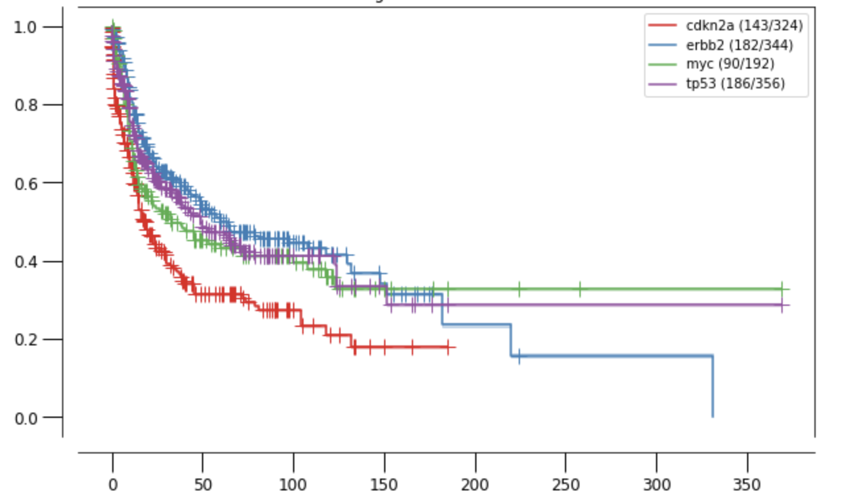
Kaplan Meier Plot: Survival based on gene
Survival function
Survival fraction
timeline
Notes:
Historically, amplification of MYC has been recognized as a marker of poor patient outcome, often occurring in patients with a particularly aggressive form of the disease.
Several studies have investigated the spectrum of copy number aberrations in Pediatric High-Grade Gliomas (pHGGs). Copy number changes in pHGGs: Focal gains have been reported in, MYC,. Most common homozygous focal loss was at CDKN2A/CDKN2B.
(Pediatric high-grade gliomas (pHGG) are the leading cause of cancer-related death in children. )

Slide 13
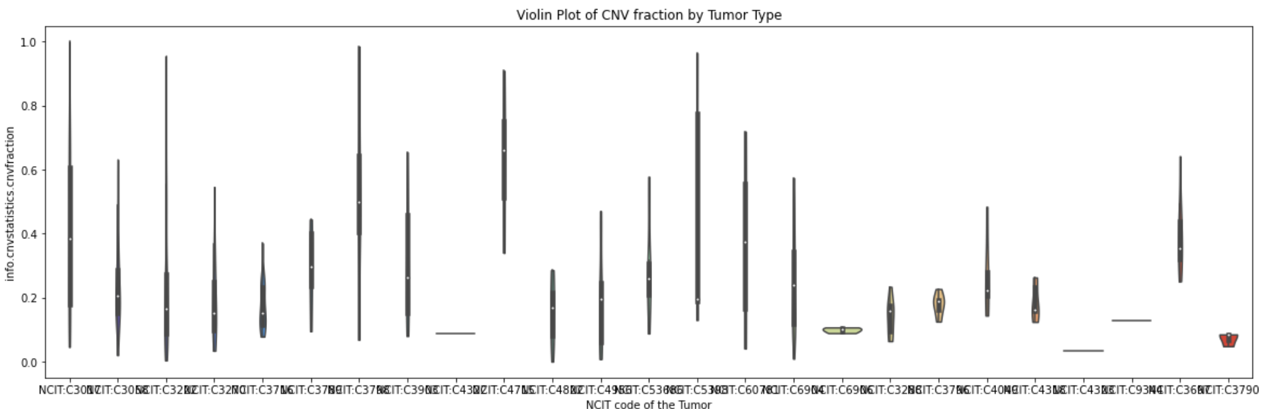
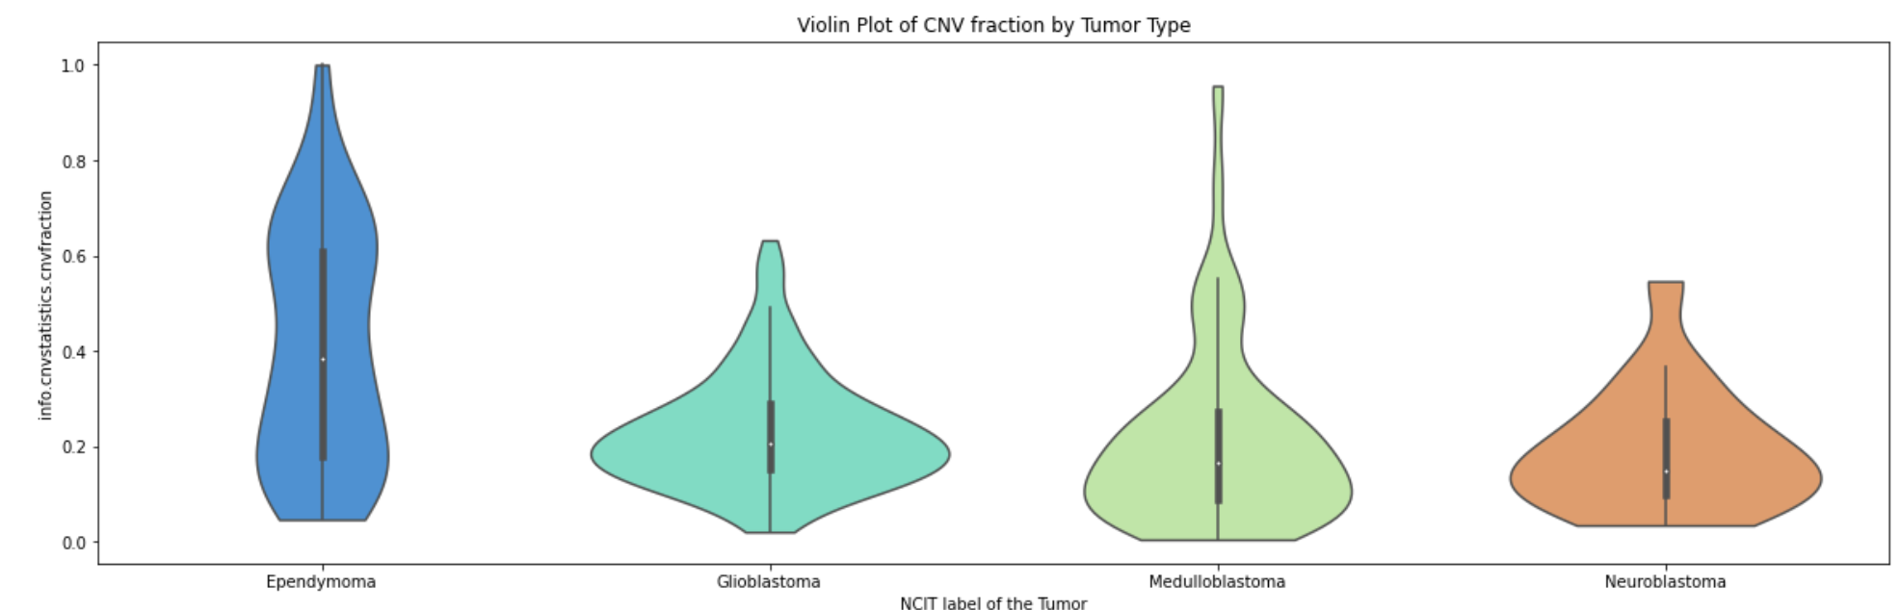
Violin Plot of CNV fraction by Tumor Type

Slide 14
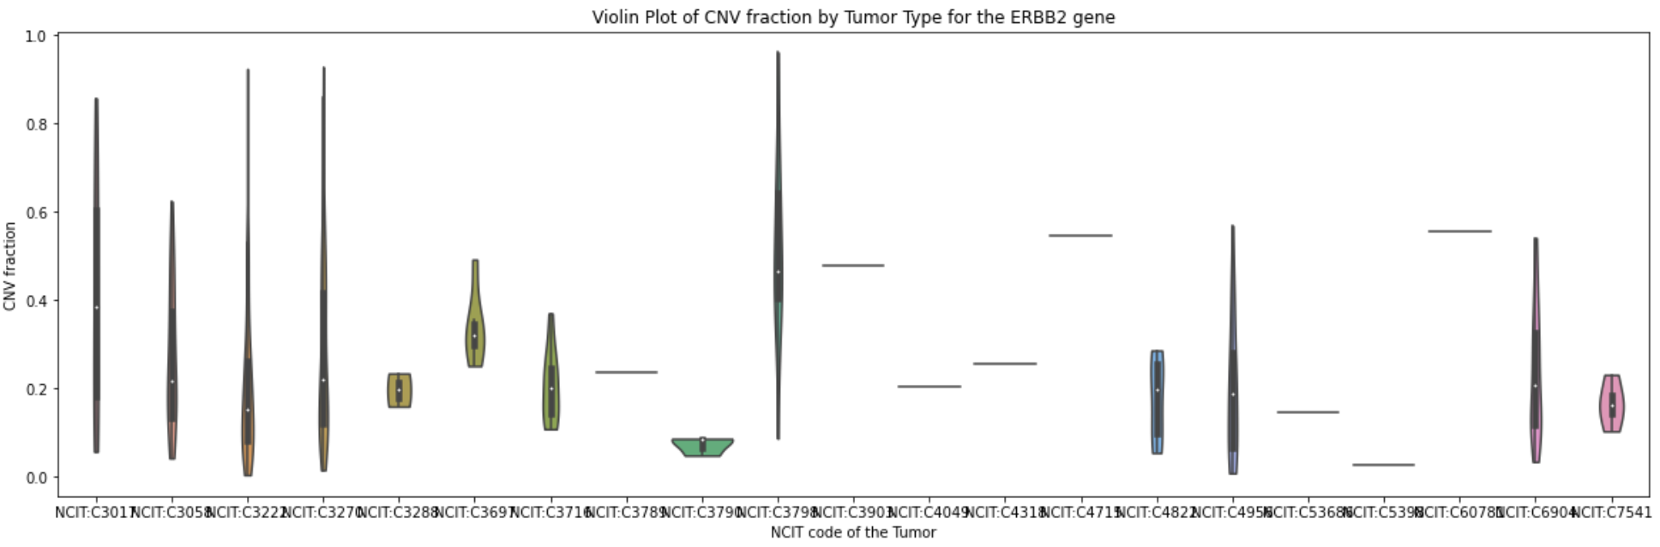
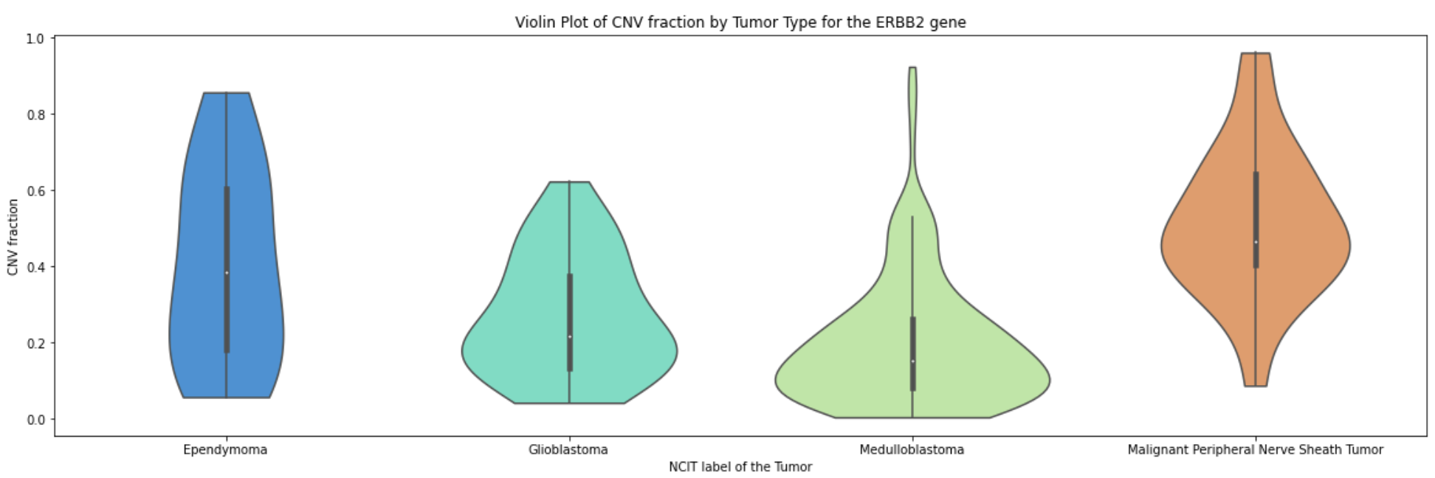
CNV fraction by Tumor Type ERBB2

Slide 15
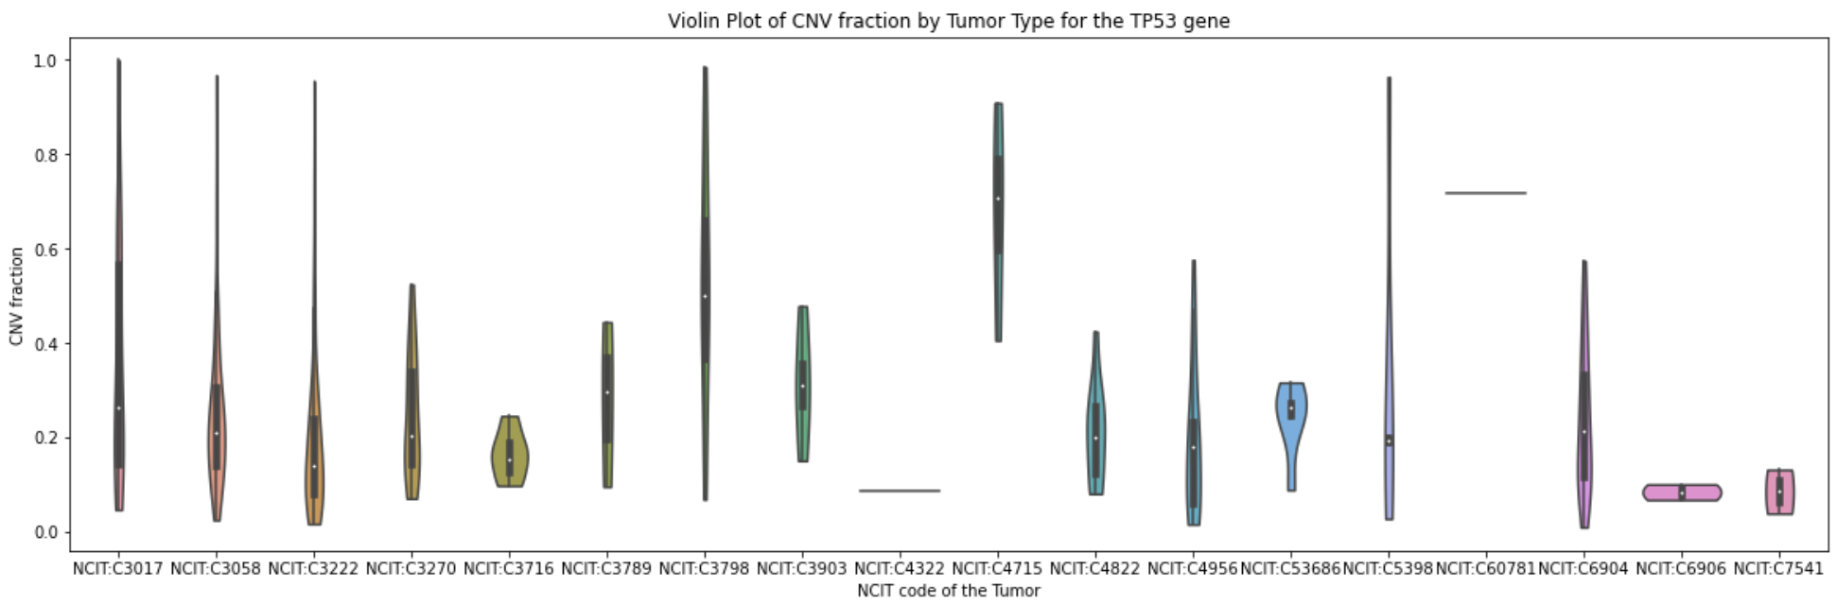
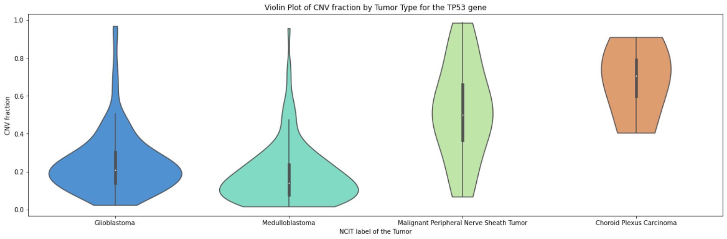
CNV fraction by Tumor Type TP53

Slide 16
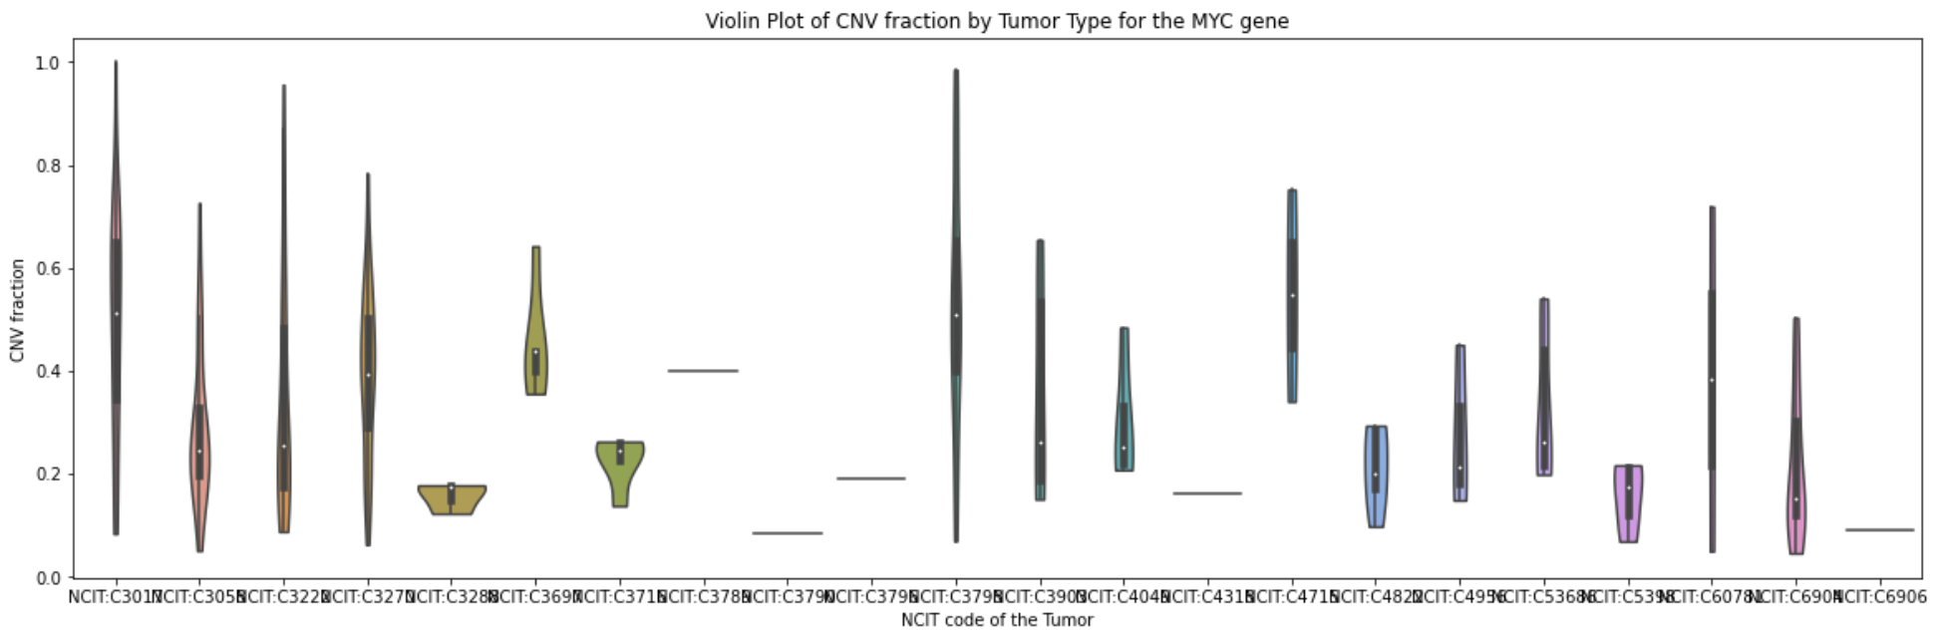
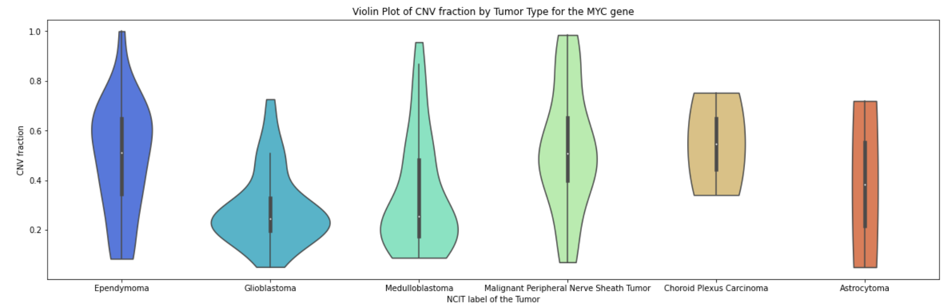
CNV fraction by Tumor Type MYC

Slide 17
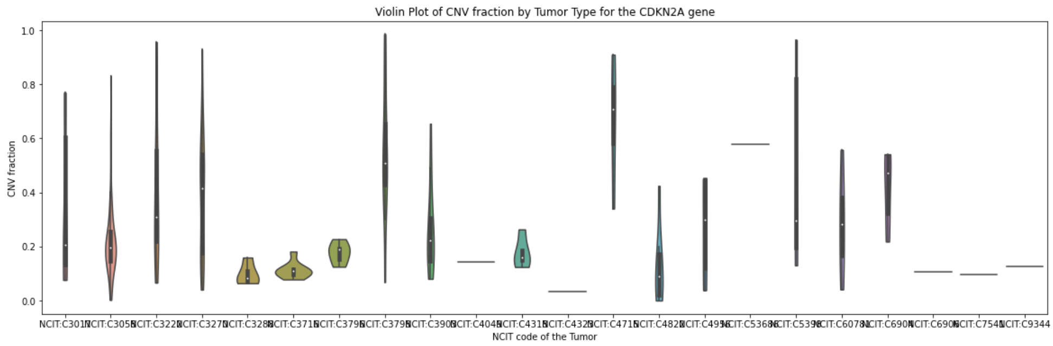
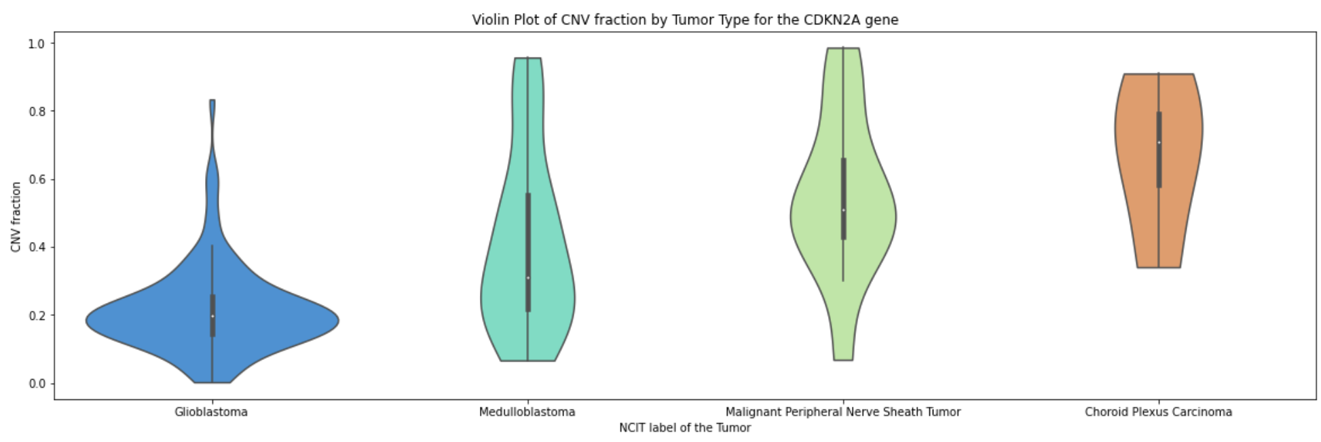
CNV fraction by Tumor Type CDKN2A

Slide 18

Conclusion

Slide 19
Sources
https://utswmed.org/conditions-treatments/nervous-system-tumors/
http://progenetix.org/cgi/PGX/cgi/collationPlots.cgi?datasetIds=progenetix&id=NCIT:C3268
https://www.mayoclinic.org/diseases-conditions/glioblastoma/cdc-20350148
https://www.mayoclinic.org/diseases-conditions/medulloblastoma/cdc-20363524
https://academic.oup.com/jnen/article/61/3/215/2609899?login=false
https://www.aaroncohen-gadol.com/patients/glioma/glioma-what-the-patient-needs-to-know
Molecular Pathology of Nervous System Tumors Biological Stratification and Targeted Therapies (Matthias A. Karajannis, David Zagzag ,2015)

